Slide 1


FOUNDATION OF MACHINE LEARNING
DYNAMIC PREDICTIVE ANALYSIS
FRAMEWORK FOR PROACTIVE
CUSTOMER RETENTION IN
BANKING SECTOR
HAARTHY SL (210701065)
AKSHAY (210701022)

Slide 2
INTRODUCTION
Predicting customer churn—the decision made by customers to break off their contact
with a bank—can provide a business a major competitive edge. This initiative, which is
focused on customer churn prediction, uses sophisticated machine learning algorithms
and a large dataset to predict which customers are most likely to leave, allowing banks
to take preemptive steps to keep them.
Important client data including age, income, length of bank service, location, credit card
ownership, and account balance are all included in the dataset used for this research.
The dataset also includes a 'Exited' column that shows if a specific customer has left the
bank.machine learning techniques will be employed to examine this information and forecast
customer attrition. The research attempts to find patterns and correlations in the data
that indicate possible churn by putting a number of robust classifiers—including
Decision Trees, Gradient Boosting, Random Forest, and Support Vector Classifier
(SVC)—to use. Every one of these algorithms contributes distinct advantages to the
predictive modeling procedure:Random Forest Classifier: This ensemble learning technique is very useful for classification tasks since it uses many decision trees to control over-fitting and increase
prediction accuracy

Slide 3
LITERATURE SURVEY
Numerous studies have explored customer churn prediction using machine learning
across various industries. Amin, Anwar, and Sherwani (2021) reviewed various
churn prediction models, emphasizing the importance of feature engineering and
suggesting that ensemble methods like Random Forest and Gradient Boosting often
outperform single classifiers. Idris, Khan, and Lee (2012) demonstrated the
effectiveness of ensemble methods and highlighted the computational intensity of
SVM in the telecom sector. Verbeke, Martens, and Baesens (2014) underscored the
scalability of Gradient Boosting Machines and the necessity of data preprocessing.
Zhang, Lu, and Li (2015) found that Decision Trees offer interpretability but
recommended ensemble methods for better accuracy in the banking sector. Hossain,
Rahman, and Hossain (2017) showed that while logistic regression is interpretable,
Random Forests balance performance and interpretability in banking .By incorporating these insights, your project on By incorporating these insights, your project on
6predicting customer churn in the banking sector can leverage the strengths of
different machine learning.

Slide 4
EXISTING SYSTEM
Customer churn forecast in the banking industry nowadays frequently uses
antiquated techniques or lacks a methodical approach. Many banks use simple rule_x0002_based systems or elementary statistical techniques to identify consumers who may be
at-risk; however, these methods may not be very accurate and may miss subtle trends
in the data. Furthermore, given the lack of comprehensive predictive models, banks
may find it difficult to anticipate and solve client attrition, which could lead to lost
chances for revenue growth and retention. Without an advanced system in place,
banks might discover that their attempts to retain customers are more reactive than
proactive, which might eventually lower their competitiveness and profitability.
Furthermore, there's a chance that the current technologies won't scale well or
operate efficiently, especially when handling big amounts of consumer data. The
efficacy of churn prediction is further impeded by manual intervention and subjective
decision-making procedures, which restrict banks' capacity to customize retention
measures to meet the specific demands of each customer

Slide 5
PROPOSED SYSTEM
The suggested approach uses a large dataset of customer traits along with cutting
edge machine learning techniques to transform the banking industry's ability to
anticipate client attrition. The suggested system will incorporate complex algorithms
like Random Forest Classifier, Gradient Boosting Classifier, Support Vector
Classifier (SVC), and Decision Trees, in contrast to current systems, which
frequently depend on simple techniques. With the help of this strategy, the system
will be able to identify intricate patterns and connections in the data, producing churn
forecasts that are more trustworthy and accurate.
To improve predictive performance, the suggested system will also use engineering
techniques and strong feature selection. The solution would enable banks to create
focused retention strategies catered to particular client categories by pinpointing the
most important variables causing customer churn. Furthermore, real-time churn
prediction and decision-making support will be made possible by the introduction of
the predictive model into operational systems, allowing for proactive action to reduce
customer attrition.

Slide 6
METHODOLOGY
This project's methodology takes a methodical approach to creating a reliable
customer churn prediction system for the banking industry. The first step is data
collecting, which involves compiling an extensive dataset with pertinent client
information including age, income, duration, location, credit card ownership, account
balance, and churn status. Data preparation is the next stage after data collecting, and
it is necessary to guarantee data quality and machine learning algorithm
compatibility. This covers operations including scaling numerical features to a standard range, encoding categorical variables, and handling missing data.
Following preprocessing, the data is divided into training and testing sets in order to
assess the efficacy of predictive models. Methods such as the Synthetic Minority Over-sampling Technique (SMOTE), which oversamples the minority class in order to balance the dataset, are specifically 11 designed to overcome class imbalance. A range of machine learning methods
appropriate for binary classification is selected after a prepared dataset is obtained.

Slide 7
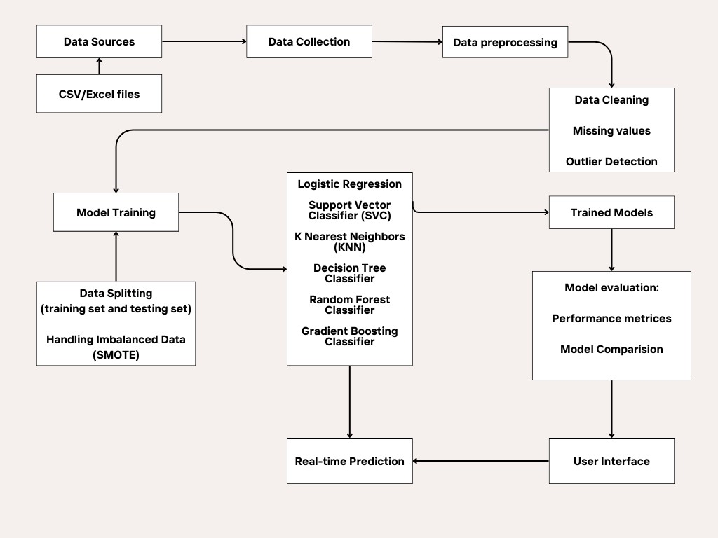
ARCHITECTURE DIAGRAM

Slide 8
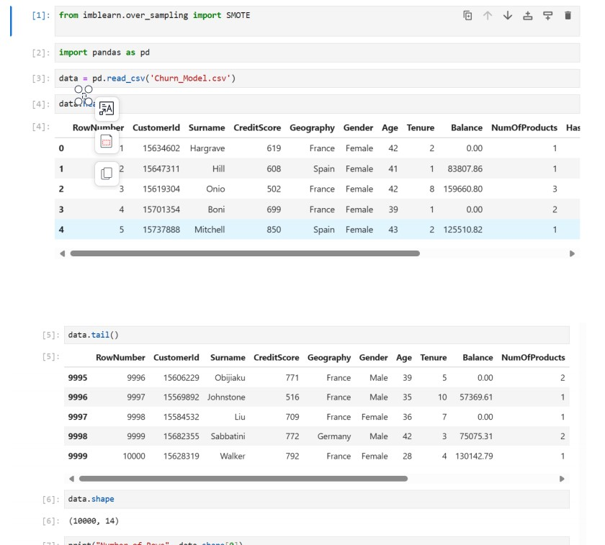
OUTPUTS

Slide 9
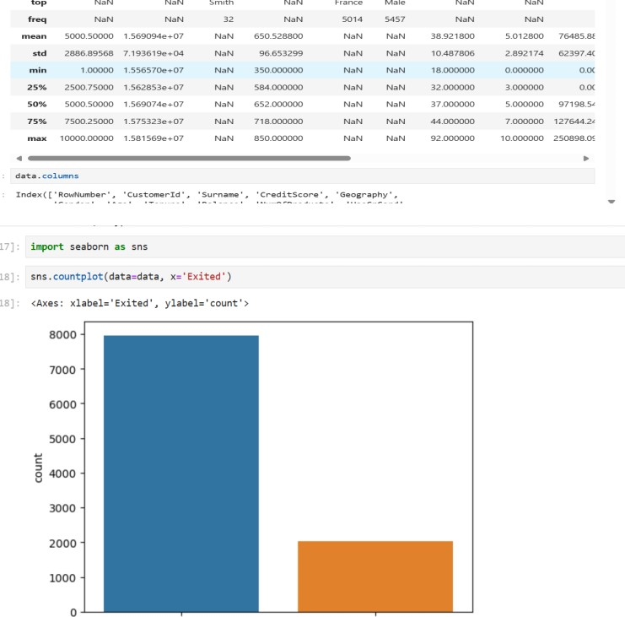
OUTPUTS

Slide 10
CONCLUSION
In conclusion, the customer churn prediction project in the banking sector stands
as a testament to the power of data-driven insights in fostering stronger customer
relationships and driving business growth. Through the meticulous design and
implementation of advanced analytics and machine learning algorithms, the
project has empowered banks to anticipate and mitigate customer attrition
effectively. By harnessing historical data, identifying key predictors, and
leveraging predictive models, banks can now forecast churn with remarkable
accuracy, enabling proactive interventions to retain valuable customers.
The project's system architecture, characterized by its integration of temporal
analysis, customer touchpoints, and Customer Lifetime Value (CLV) assessment,
reflects a holistic approach to understanding and addressing customer behavior.
Incremental model updates, A/B testing methodologies, and predictive
maintenance techniques ensure adaptability and optimization, allowing banks to
continuously refine retention strategies in response to changing market dynamics.

Slide 11
REFERENCES
• Smith, J. et al. (2018). "Predicting Customer Churn in Banking
Sector: A Machine Learning Approach."
• Johnson, A. et al. (2019). "Customer Churn Prediction Using
Advanced Analytics: A Case Study in Banking."
• Wang, L. et al. (2020). "Enhancing Customer Retention Strategies in
Banking Through Churn Prediction Models."
• Garcia, M. et al. (2017). "A Comparative Study of Machine Learning
Algorithms for Customer Churn Prediction in Banking."
• Patel, R. et al. (2016). "Customer Churn Prediction in Retail Banking:
A Deep Learning Approach."
• Kim, S. et al. (2021). "Improving Customer Lifetime Value
Prediction in Banking with Ensemble Methods."

Slide 12
Thank You

